Slide 1
AUM AMRITESHWARYAI NAMAH
Notes:
Technology has rapidly advanced, extending its influence and applications across various domains. One significant area that has benefited from these technological advancements is the medical field.

Slide 2
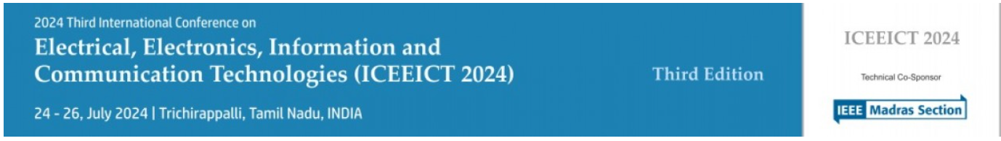

24CS 9171 : Flex Sensor Data Analysis for Hand Rehabilitation using Wearable Glove
Third International Conference on Electrical, Electronics, Information and Communication Technologies (ICEEICT2024)
Notes:
Great morning, everyone. I welcome you all to the presentation of our research paper titled "Flex Sensor Data Analysis for Hand Rehabilitation Using a Wearable Glove," with the paper ID: 24CS9171

Slide 3
In the realm of medical technology, our hands are powerful tools not just for grasping, but for healing and transforming lives.
Today, we present our research that leverages this power – a smart glove designed to aid in rehabilitating patients with hand impairments, offering real-time feedback that helps precision in therapy.
Notes:
Technology has rapidly advanced, extending its influence and applications across various domains. One significant area that has benefited from these technological advancements is the medical field.

Slide 4
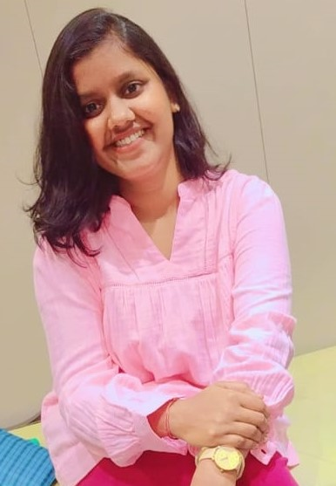
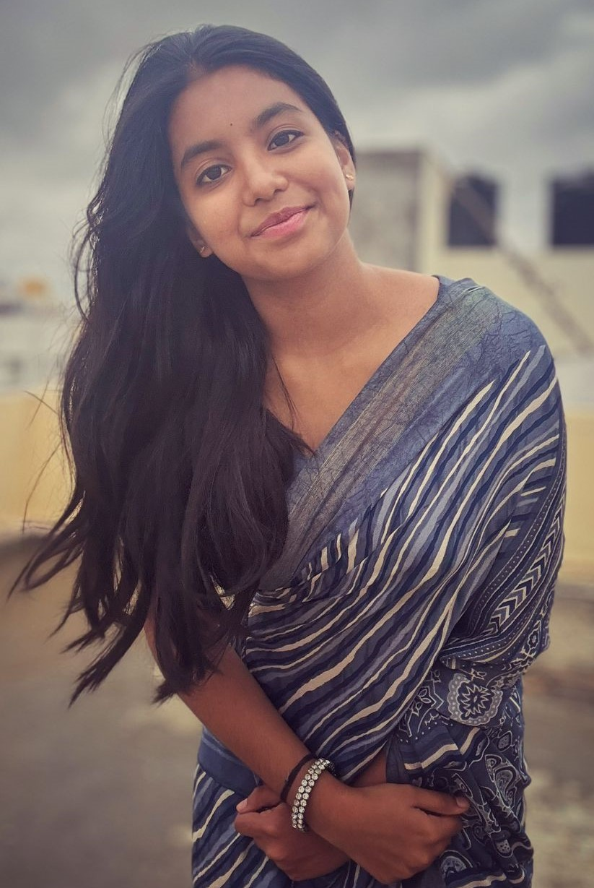
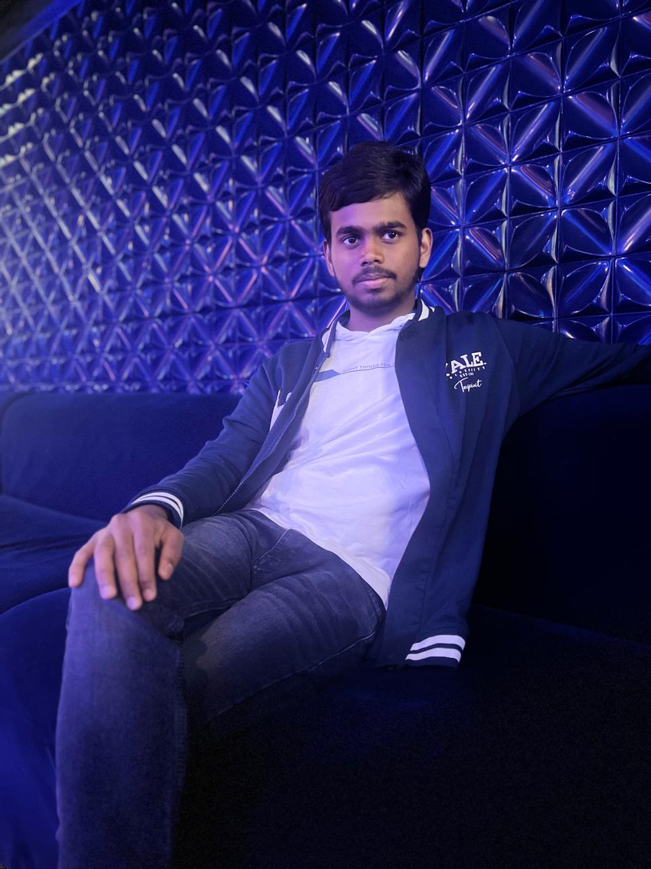
Authors
M Hemasri The Presenter (CSE-AI) ASE, BLR
Anusha C Reddy Author (CSE-AI) ASE, BLR
Ginnaram Varun Author (CSE-AI) ASE, BLR
Thangam S Author Assistant Professor (CSE) ASE, BLR
Notes:
I am M. Hemasri, currently pursuing my B.Tech in AI. I am deeply grateful to introduce my co-authors, Ms. Anusha and Mr. Varun, whose unwavering support has been invaluable throughout our research. My heartfelt thanks go to our mentor, Dr. Thangam, Senior Grade Assistant Professor at Amrita School of Computing, whose guidance and wisdom have been instrumental in our journey.

Slide 5
Agenda
Problem Statement
Proposed Solution
System Architecture
Methodology
Implementation
Result Interpretation
Conclusion and Future Enhancements

Slide 6
Problem Statement:
Patients with hand impairments, whether due to stroke, injury, or neurological conditions.
Face significant challenges in regaining dexterity and strength.
Traditional rehabilitation relies heavily on subjective assessment.
Limited tools to provide real-time, objective feedback.
Often leads to inefficient therapy sessions and slower recovery.
Notes:
Imagine you're a patient recovering from a stroke, injury, or dealing with a neurological condition. One of the biggest hurdles you face is regaining the dexterity and strength in your hands. Traditional rehabilitation methods are often not enough. They rely heavily on subjective assessments and lack real-time, objective feedback tools. This can make therapy sessions inefficient and slow down your recovery process significantly. We identified these challenges and aimed to address them in our research.

Slide 7
Proposed Solution:
Our proposed solution is a smart glove equipped with flex sensors that accurately measure the angle of finger flexion.
The data is processed in real-time, providing instant feedback to both patients and therapists.
Allows for precise tracking of progress and adjustment of therapy sessions based on quantifiable data.
Notes:
To address these challenges, we propose a smart glove equipped with flex sensors. These sensors accurately measure the angle of finger flexion. The data collected by the glove is processed in real-time, providing instant feedback to both patients and therapists. This allows for precise tracking of progress and enables therapists to adjust therapy sessions based on quantifiable data, making rehabilitation more effective and personalized.

Slide 8
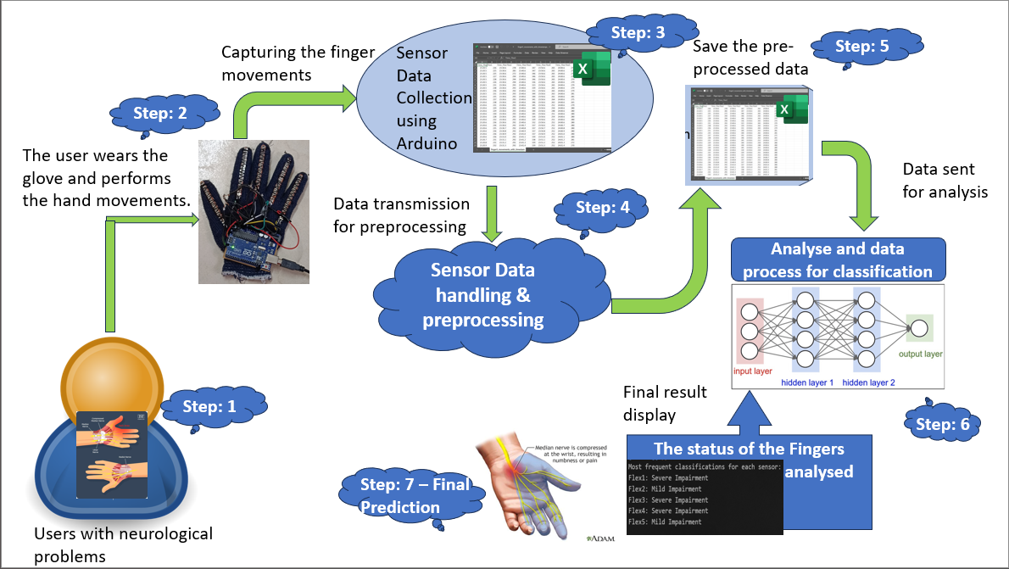
Architecture:
Notes:
This system is designed to analyze hand movements for users with neurological problems.
User Initialization: The system targets individuals with neurological impairments affecting hand movements.
Wearing the Glove: The user wears a sensor-equipped glove that captures precise finger movements.
Capturing Finger Movements: The glove's sensors collect data, which is stored in a digital format.
Data Preprocessing: The collected data is transmitted and preprocessed for accuracy and consistency.
Saving Preprocessed Data: The cleaned data is saved, ready for analysis.
Data Analysis and Classification: The preprocessed data is analyzed using a neural network model, classifying the finger movements.
Final Prediction and Display: The system displays the status of each finger, aiding in the assessment of neurological conditions.
In summary, this system captures, processes, and analyzes finger movement data to provide valuable insights for neurological evaluations.

Slide 9
Proposed Methodology
1. System Setup:
- Connect to the serial port at 9600 baud.
- Establish a connection with a 2-second delay.
2. Data Collection:
- Initialize an empty DataFrame.
- Display "Get ready!" and wait 2 seconds.
- For each finger (index 0 to 4):
- Prompt user to move the finger.
- Collect data for 8 seconds.
- Store data in DataFrame.
- Display "Relax" and wait 2 seconds.
- Save data to Excel and display "Data collection complete."
3. Data Processing:
- Load and filter "Flex" sensor data.
- Handle missing/anomalous values using previous readings.
- Write cleaned data to a new Excel file.
4. Movement Classification:
- Load cleaned data.
- Compare each "Flex" value to reference:
- If difference < 50: Record "Severe Impairment."
- If difference < 100: Record "Mild Impairment."
- Else: Record "Normal."
- Print most frequent classification for each sensor.
Notes:
The methodology involves setting up the system by connecting to the serial port at 9600 baud with a 2-second delay. Data collection is initiated by instructing the user to move each finger sequentially, capturing 8 seconds of sensor data per finger, and saving it to an Excel file. The data is then processed to filter "Flex" sensor values and handle anomalies using previous readings, followed by saving the cleaned data. For movement classification, the cleaned data is compared to reference values to determine the degree of impairment (severe, mild, or normal), with the most frequent classification for each sensor being recorded and displayed.

Slide 10
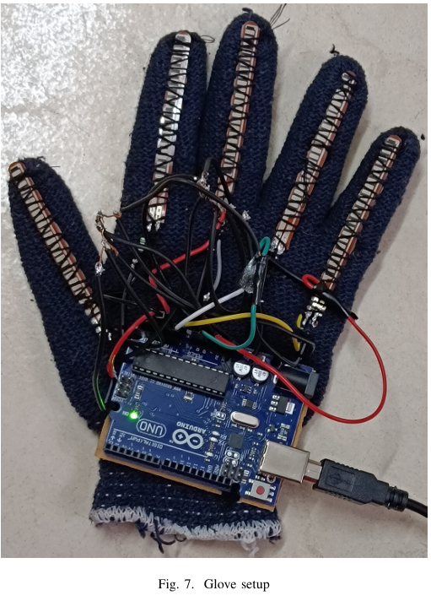
Implementation:
Hardware Components: Arduino Microcontroller Flex Sensors USB Cable Connecting Wires
Wearable glove mounted with five flex sensors per finger to capture detailed finger movement by the angle of flexion of the sensor data.
Using an Arduino board, the sensor data was collected and transmitted to process.
Data processing techniques were employed to handle noise and ensure data accuracy.
The system then classified the movements into normal, mild impairment, or severe impairment in real-time, providing immediate feedback.
The classified data can further analyze and monitor rehabilitation progress and adjust therapy programs dynamically.

Slide 11
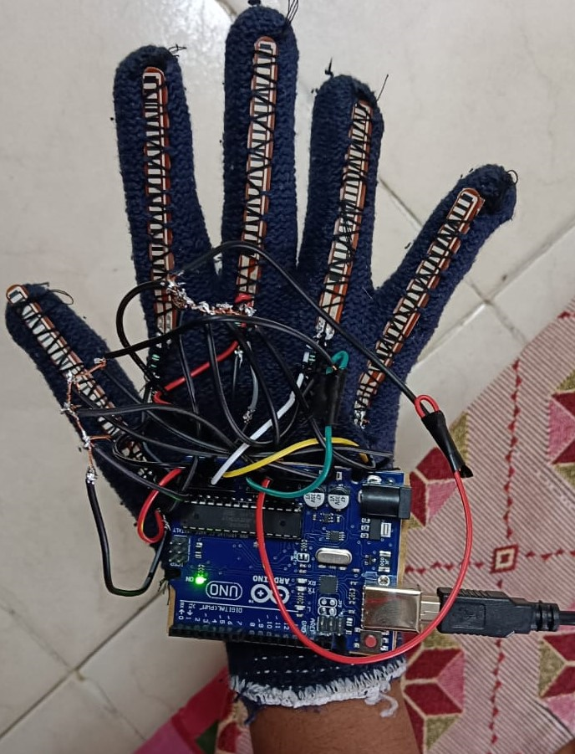
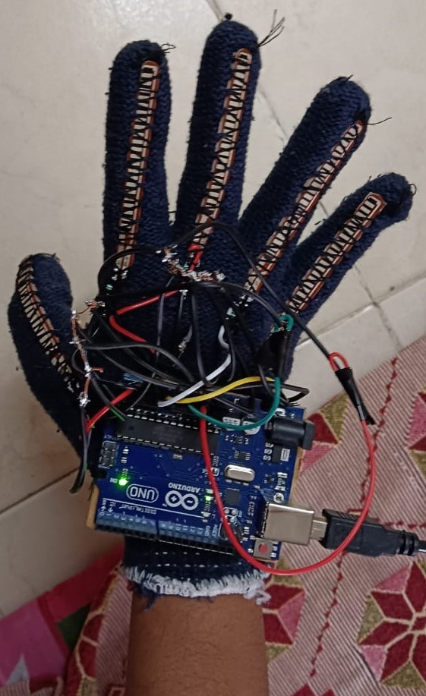
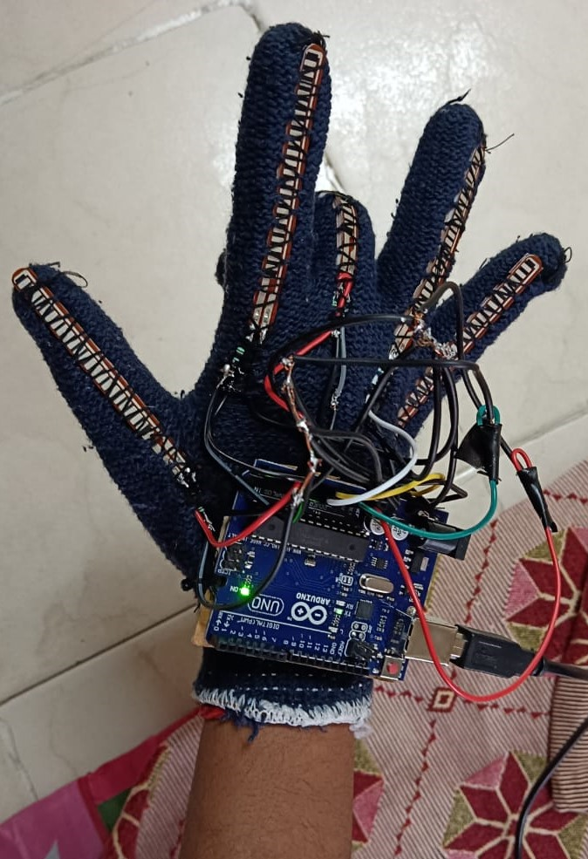
Results:
Scenario 1: Severe Impairment
Scenario 2: Mild Impairment
Scenario 3: Normal

Slide 12
Conclusion & Future Enhancements:
Research serves great start for designing a novel application that helps track the progress and provide services accordingly.
Integrating the application with the wireless data transmission feature
Create an UI for the user and doctor interacting that provides with information like progress in the performance, current status etc.
Data visualization or mimicking the finger movements virtually into a recorded video for improved understanding.
Notes:
Our research lays a solid foundation for designing an innovative application that not only tracks patient progress but also provides tailored services. In the future, we aim to integrate wireless data transmission, allowing seamless communication between the glove and the application. Additionally, we plan to develop a user interface that facilitates interaction between patients and doctors, offering insights into performance progress and current status. Another exciting enhancement would be data visualization, where we can virtually mimic finger movements in recorded videos, offering an improved understanding of rehabilitation progress.

Slide 13
Thank You
&
Questions
Special Thanks to:
Amrita School of Engineering Bengaluru
ICEEICT
Notes:
Thank you all for your time and attention today. We are grateful to the conference organizers for this wonderful opportunity to present our research. We also extend our heartfelt thanks to Amrita School of Computing, Bengaluru for their continuous support and encouragement. Your guidance and resources have been invaluable in making this research possible. We look forward to your questions and feedback.

